Slide 1


SAP BTP CPI Training

Slide 2

DISCLAIMER
The training content and delivery of this presentation is confidential, and cannot be recorded, or copied and distributed to any third party, without the written consent of Anubhav Trainings

Slide 3


Introduction

Slide 4
SAP CLOUD Connector
SAP HANA Cloud connector connects between on-demand applications in SAP HANA Cloud Platform and existing on-premise systems. The Cloud connector runs as on-premise agent in a secured network and acts as a reverse invoke proxy between the on-premise network and SAP HANA Cloud Platform.
Cloud Connector is an application that can be installed on a Windows, Linux, Mac OS operating system, which creates a secure connection to the SAP “cloud”, so that SAP Cloud products can communicate securely with systems in a customer’s on-premise/private cloud landscape.

Slide 5
Advantage
Compared to the approach of opening ports in the firewall and using reverse proxies in the DMZ to establish access to on-premise systems, the Cloud connector has the following advantages:
In order to establish connectivity from SAP HANA Cloud Platform to an on-premise system, the firewall of the on-premise network does not require to open an inbound port.
The Cloud connector can be used to connect on-premise database
The Cloud connector is easy to install and configure, that is, it comes with a low TCO and fits well to cloud scenarios. SAP provides standard support for it.

Slide 6
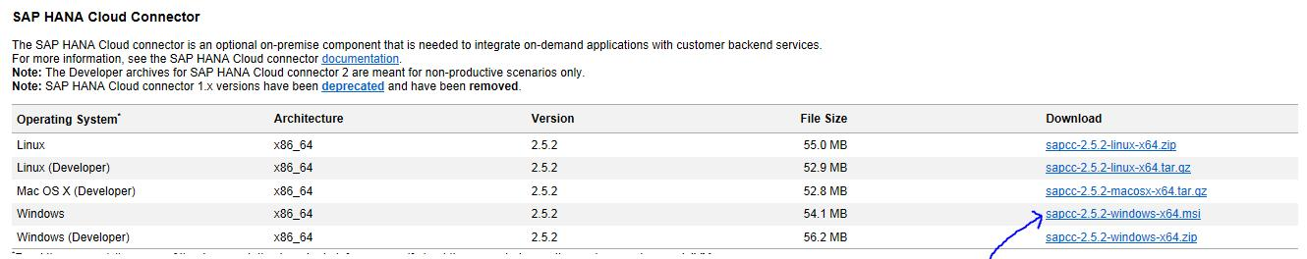
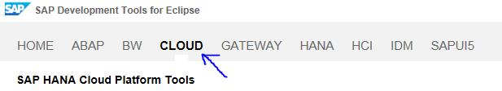
Setup the Required Software
Downloading Cloud Connector Installation Archive
Download the ZIP or MSI installer from the link: https://tools.hana.ondemand.com/#cloud
Click on Cloud

Slide 7
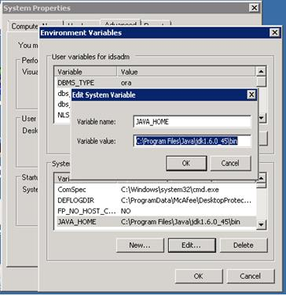
. Setup the Environment Variable

Slide 8
Post Installation Configuration
Establish connection to the cloud account
Logon to the cloud connector administration UI by invoking the URL https://localhost:8443 in a Web browser. The cloud connector logon screen then is shown in the browser. As user and password, use the pre-defined user Administrator and password manage.

Slide 9
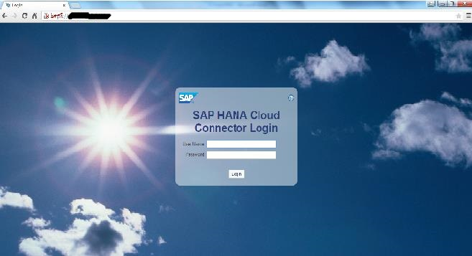

Slide 10
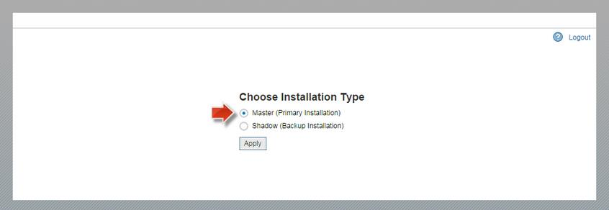

Slide 11
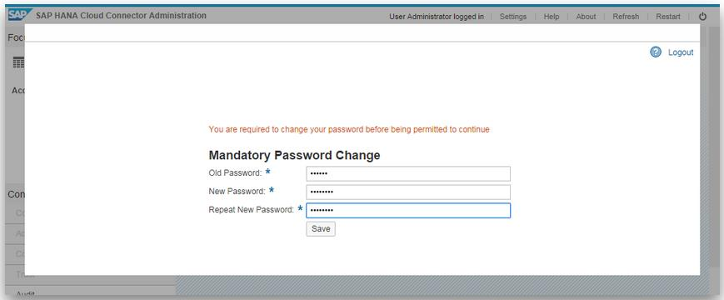

Slide 12
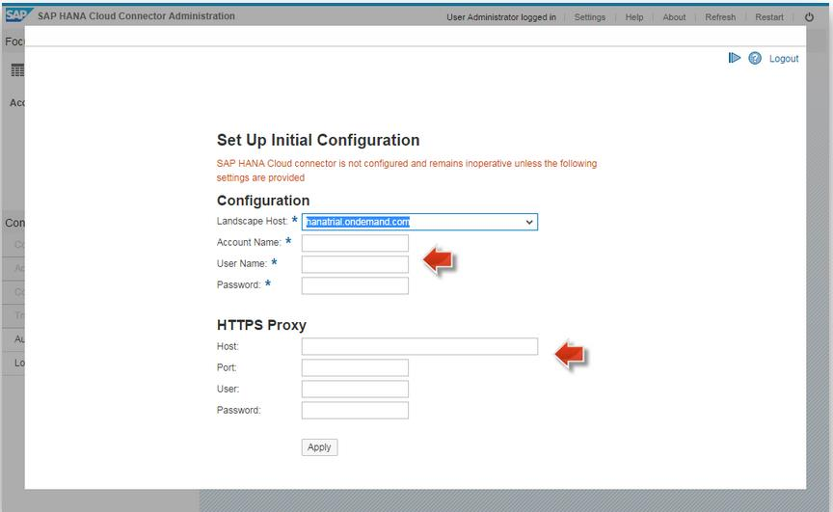
As next step, we need to connect the cloud connector with our developer account in the cloud. Make sure to select hanatrial.ondemand.com as Landscape Host, and specify our free developer account as Account Name.

Slide 13
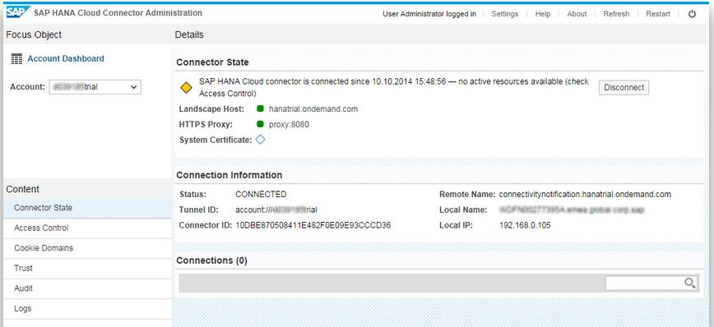
Now the main page of the cloud connector administration UI shows up. In case the connection succeeded, we will see the Connector State with a yellow indicator as shown in the following screenshot. Now, we have a persistent SSL connection to our cloud account and are ready to use this connection in our cloud applications

Slide 14
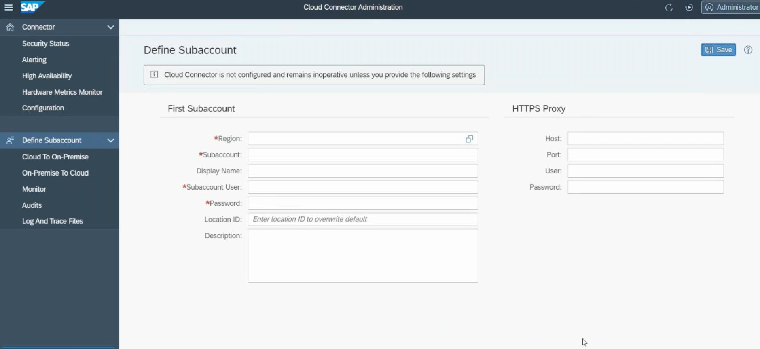

Slide 15
Exception subprocess
You use this element to catch any exceptions thrown in the integration process and handle them.
Procedure
Open your integration flow in the editor.
To add an exception subprocess to the integration flow, choose Process Exception Subprocess from the palette. The subprocess can be dropped into the integration process and should not be connected to any of the elements of the integration flow.
Select the exception subprocess.
In the property sheet specify a name.
Start the process with Error Start event always.
End the process with either End Message or Error End or Escalation event.

Slide 16
If the Escalation End Event is used within an exception subprocess, the message processing stops and the message status will be Escalated. This is regardless of whether the exception subprocess is used in the main Integration Process or a Local Integration Process.

Slide 18
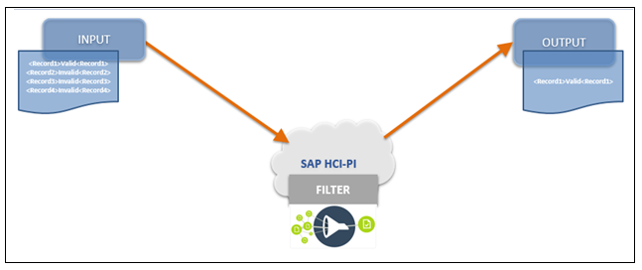
Filter Condition
Content Filter step filters required node or list of nodes or value of specific node from the incoming XML message.

Slide 19
Content Filter consist of below
Name | Valid Logical name for Filter
XPath | Expression Enter an XPATH to extract a node in the message
Value Type | Specify the type for the value you want to extract from XML Node

Slide 20
Below table provides the different type of Value Type returned from Filter.
String | Returns the String value from Node | INPUT: <NODE>VALUE1</NODE> XPATH: //NODE OUTPUT: VALUE1
Integer | Returns the Integer value from Node | INPUT:<NODE>1</NODE> XPATH: //NODE OUTPUT: 1
Boolean | Returns the Boolean value from Node | INPUT: <NODE>VALUE1</NODE> XPATH: //NODE OUTPUT: True
Node | Returns the Node value from input xml | INPUT: <NODE>VALUE1</NODE> XPATH: //NODE OUTPUT: <NODE>VALUE1</NODE>
Nodelist | Returns list of nodes from incoming XML | INPUT: <Root> <NODE>VALUE1</NODE> <NODE1>VALUE1</NODE1> </Root> XPATH: //NODE OUTPUT: <Root> <NODE>VALUE1</NODE> <NODE1>VALUE1</NODE1> </Root>

Slide 21
Use Cases:
Since the Value Types with Sting,Integer,Boolean and Node are self explanatory will get into Nodelist which we use more often in Custom Integration
Case#1:
Filter the incoming XML containing <ErrorNode>

Slide 22
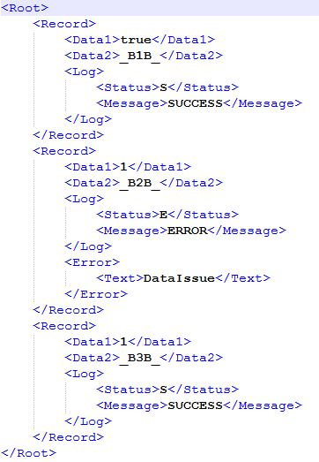
XPATH:
/Root/Record[Error]

Slide 23
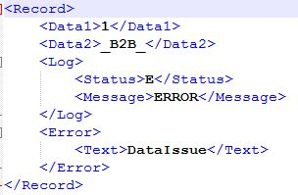
Output

Slide 24
Case#2:
Filters the Record node which contains <Status> node with value S [ Success ] or SK [ Skipped ].

Slide 25
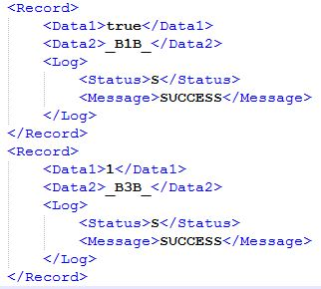
XPATH:
/Root/Record[(Log/Status/text()= ‘S’ ) or (Log/Status/text() = ‘SK’ )]

Slide 26
Case#4:
Filter the incoming XML not containing <ErrorNode>

Slide 27
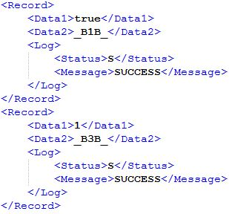
XPATH:
/Root/Record[not(Error)]

Slide 28
Data store adapter
This adapter enables Cloud Integration to consume messages from a data store. This feature helps you to enable asynchronous decoupling of inbound and outbound processing by using the data store as temporary storage.
To understand the concept of asynchronous decoupling, assume that a sender sends a message to Cloud Integration (inbound processing). If there's an error in outbound processing (for example, a receiver can't be reached temporarily), the middleware (Cloud Integration) retries message processing independently. There's no need that the sender triggers a reprocessing of the message as soon as the error situation is fixed. The sender relies on the middleware to do that. To support this scenario, Cloud Integration stores the message received from the sender in the data store. To implement this step, you can design a dedicated integration flow that receives the sender's message and uses a Data Store Write step to store it in the data store

Slide 29
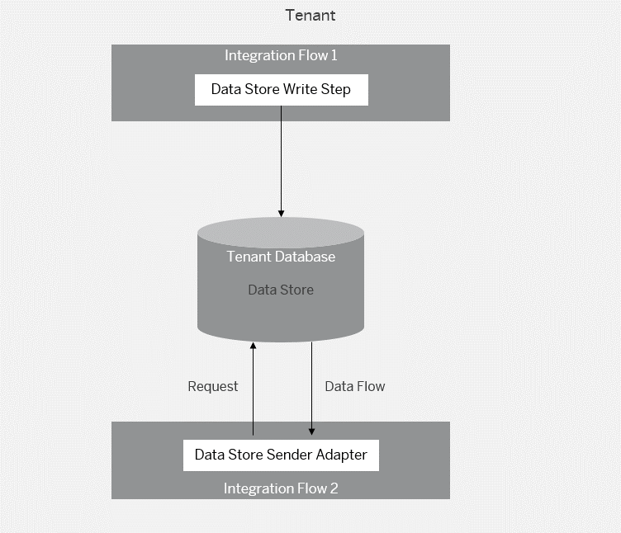
Furthermore, you model outbound processing in an integration flow that initially consumes the message from the data store (using the Data Store sender adapter). The outbound integration flow retries the message from the data store as long as the error situation lasts.

Slide 30
API Management
SAP API Business Hub is a website to discover, explore, and test APIs from various SAP products such as SAP S/4HANA, SAP SuccessFactors, SAP Customer Experience, SAP BTP, and selected partners. Apart from various product APIs, you can find detailed information on business processes and partner assets. The new workspace feature also enables you to consume integration and workflow content.
https://api.sap.com/

Slide 31
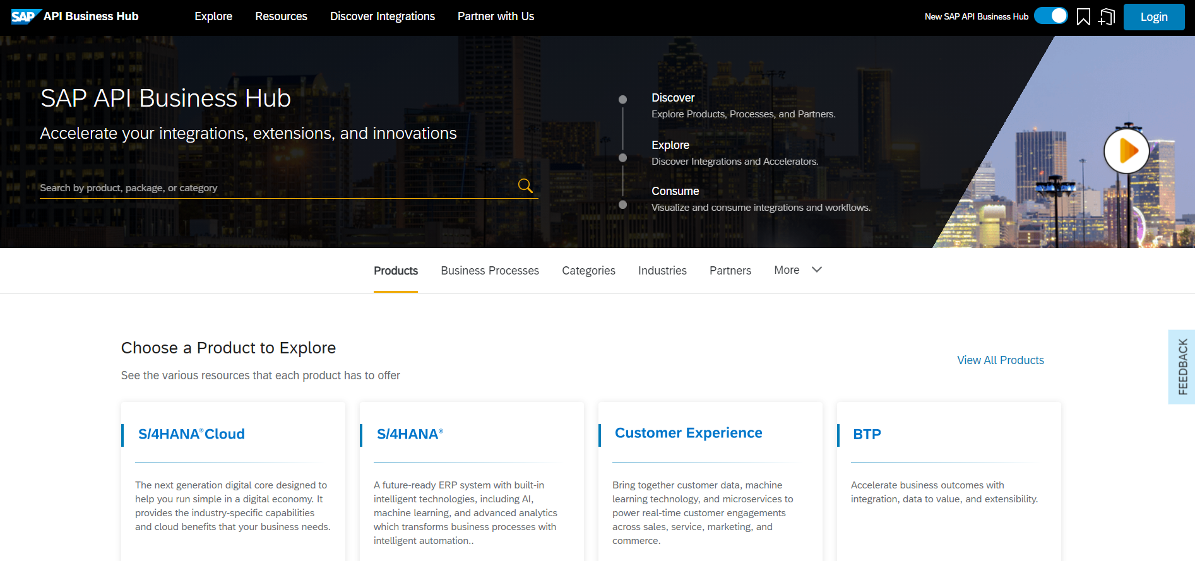
STEP 1 Go to the SAP API Business Hub
In your browser, open SAP API Business Hub
You can explore products, business processes, as well as different categories of assets, along with partner and featured content. Choose Explore for quick access to the various sections of the SAP API Business Hub.

Slide 32
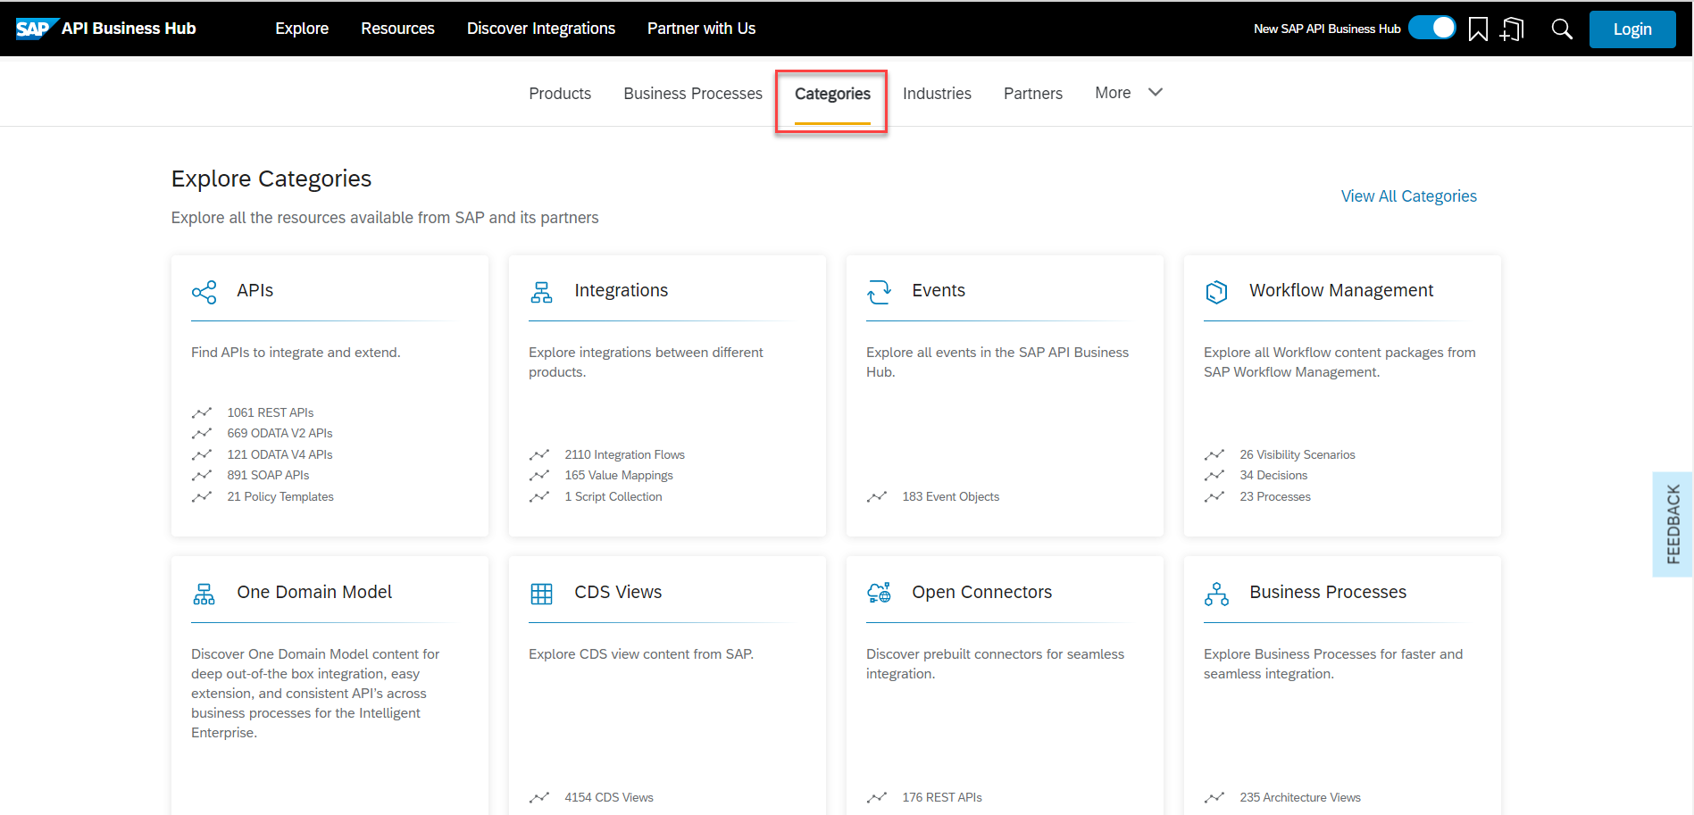
Step 2 Explore API content
On the SAP API Business Hub homepage, choose Categories.

Slide 33
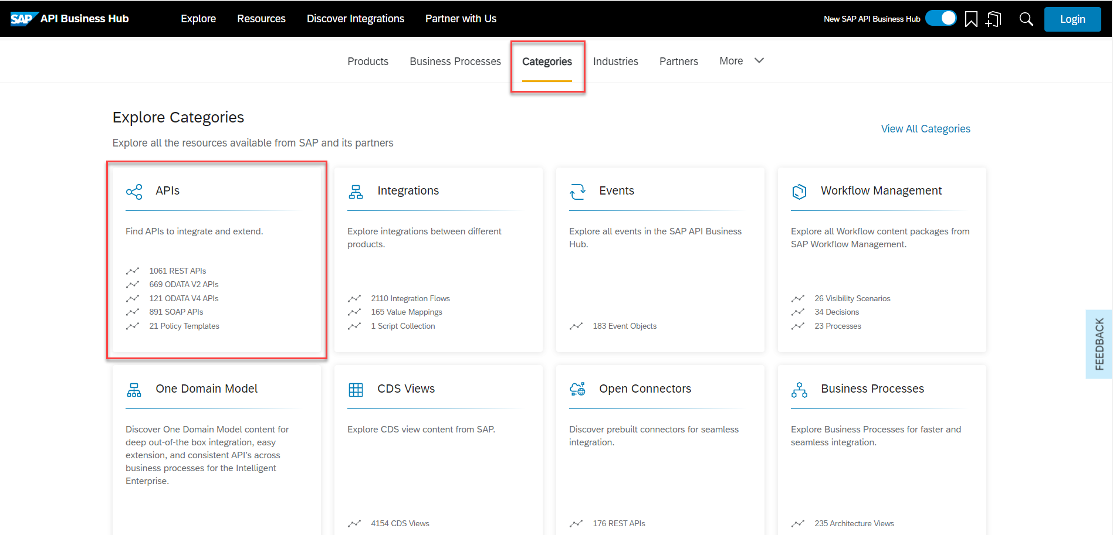
Choose APIs from the different categories available.

Slide 34
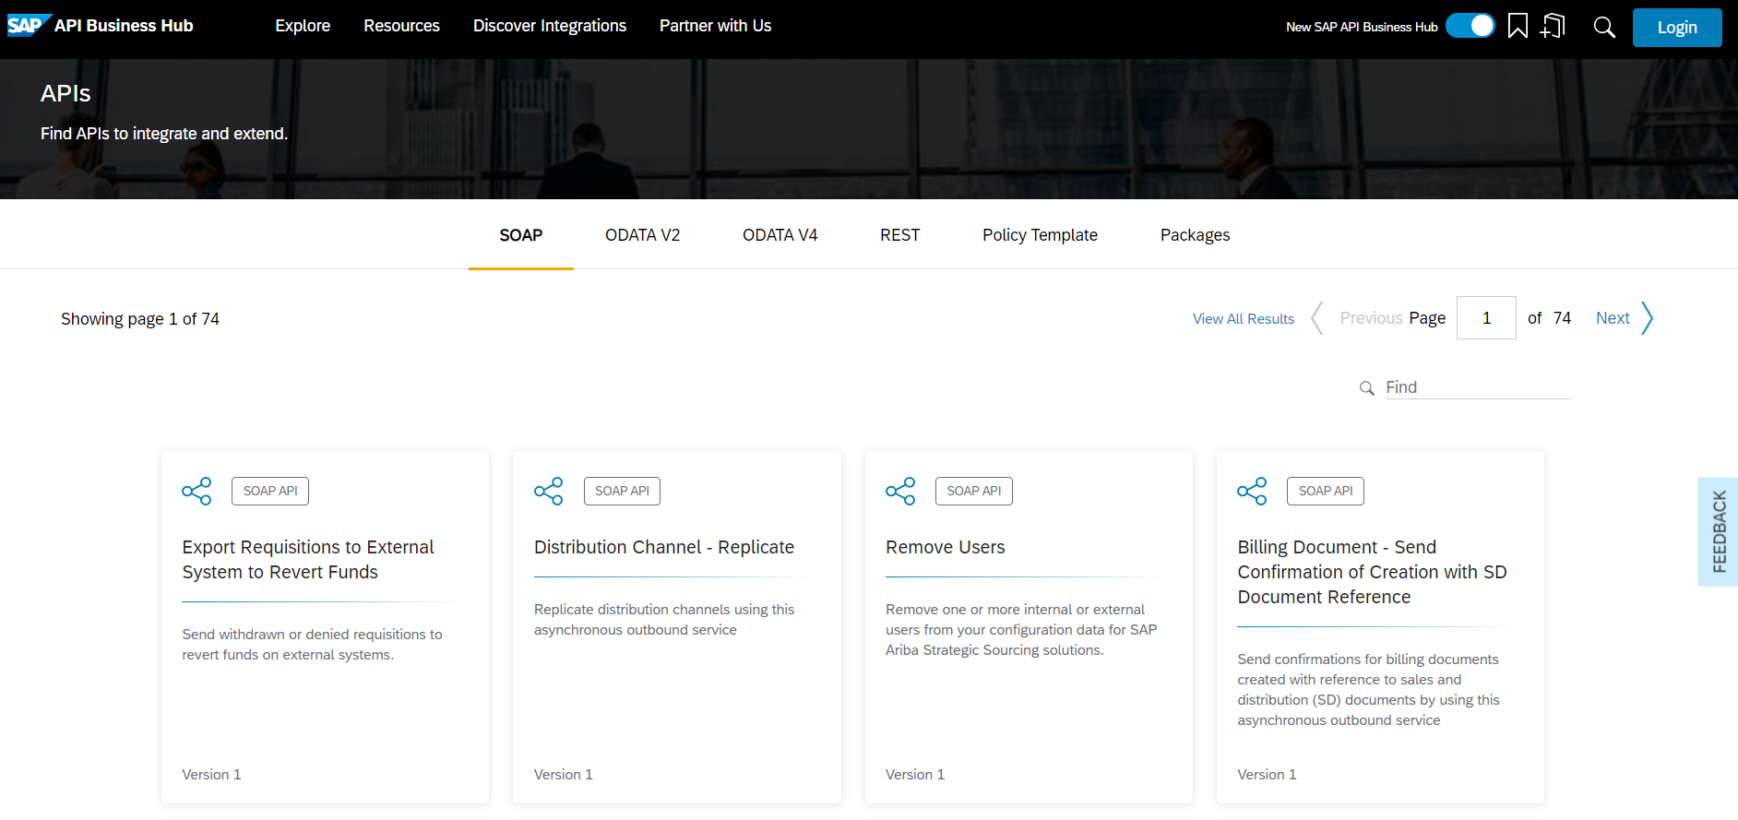
Step 3 Search for an API
Different APIs, policy templates, and API packages are available under the API category. An API package contains one or more APIs. You can browse through different types of APIs such as REST, OData, and SOAP APIs.

Slide 35
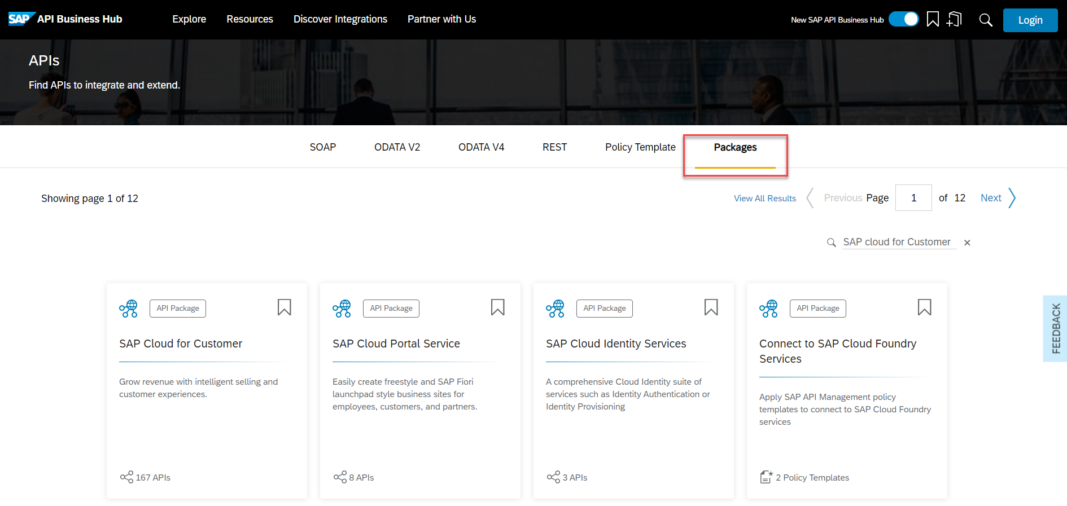
You can explore APIs either by selecting a type of an API or by selecting an API package. Navigate to the Packages tab. You can choose any package for testing.

Slide 36
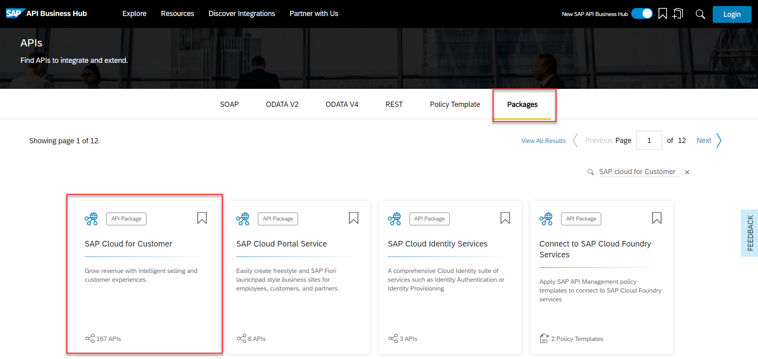
For the purpose of this tutorial, we are going to choose th SAP Cloud for Customer package (find it using the search facility).

Slide 37
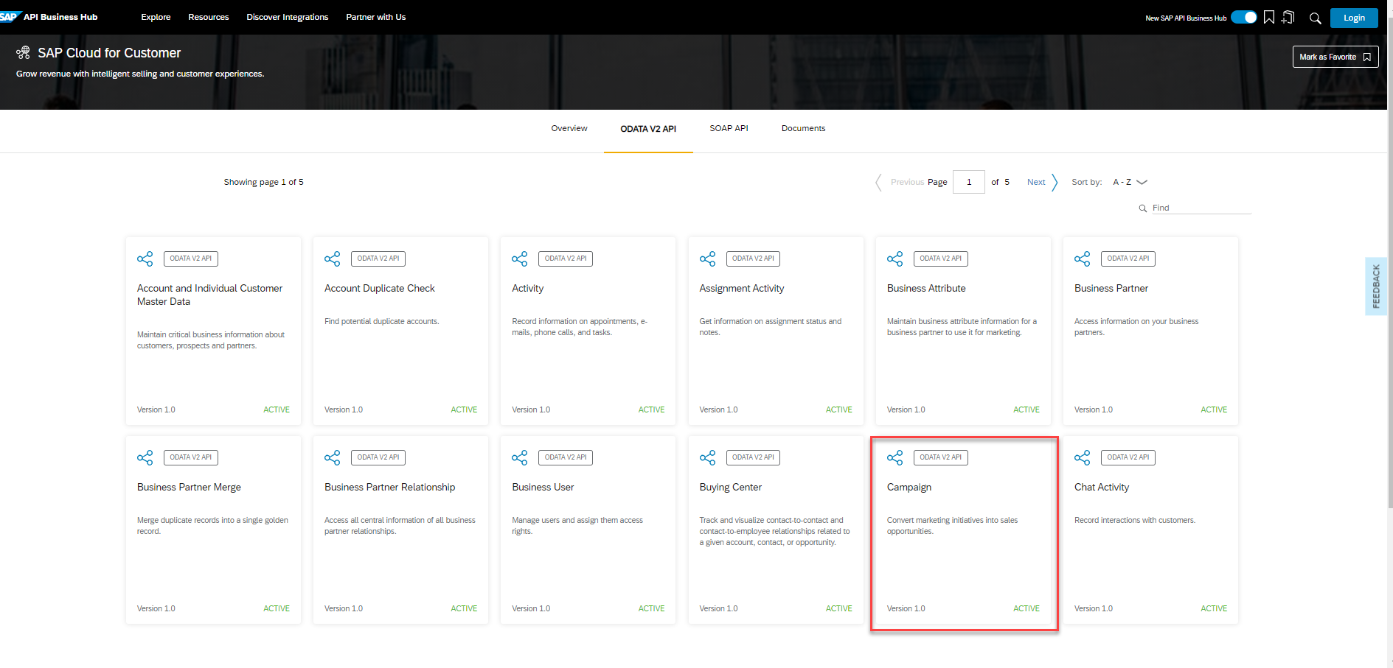
Step 4 Explore the API On choosing the SAP Cloud for Customer package, you can view the available APIs in the package. Select the Campaign API to explore it in detail.

Slide 38
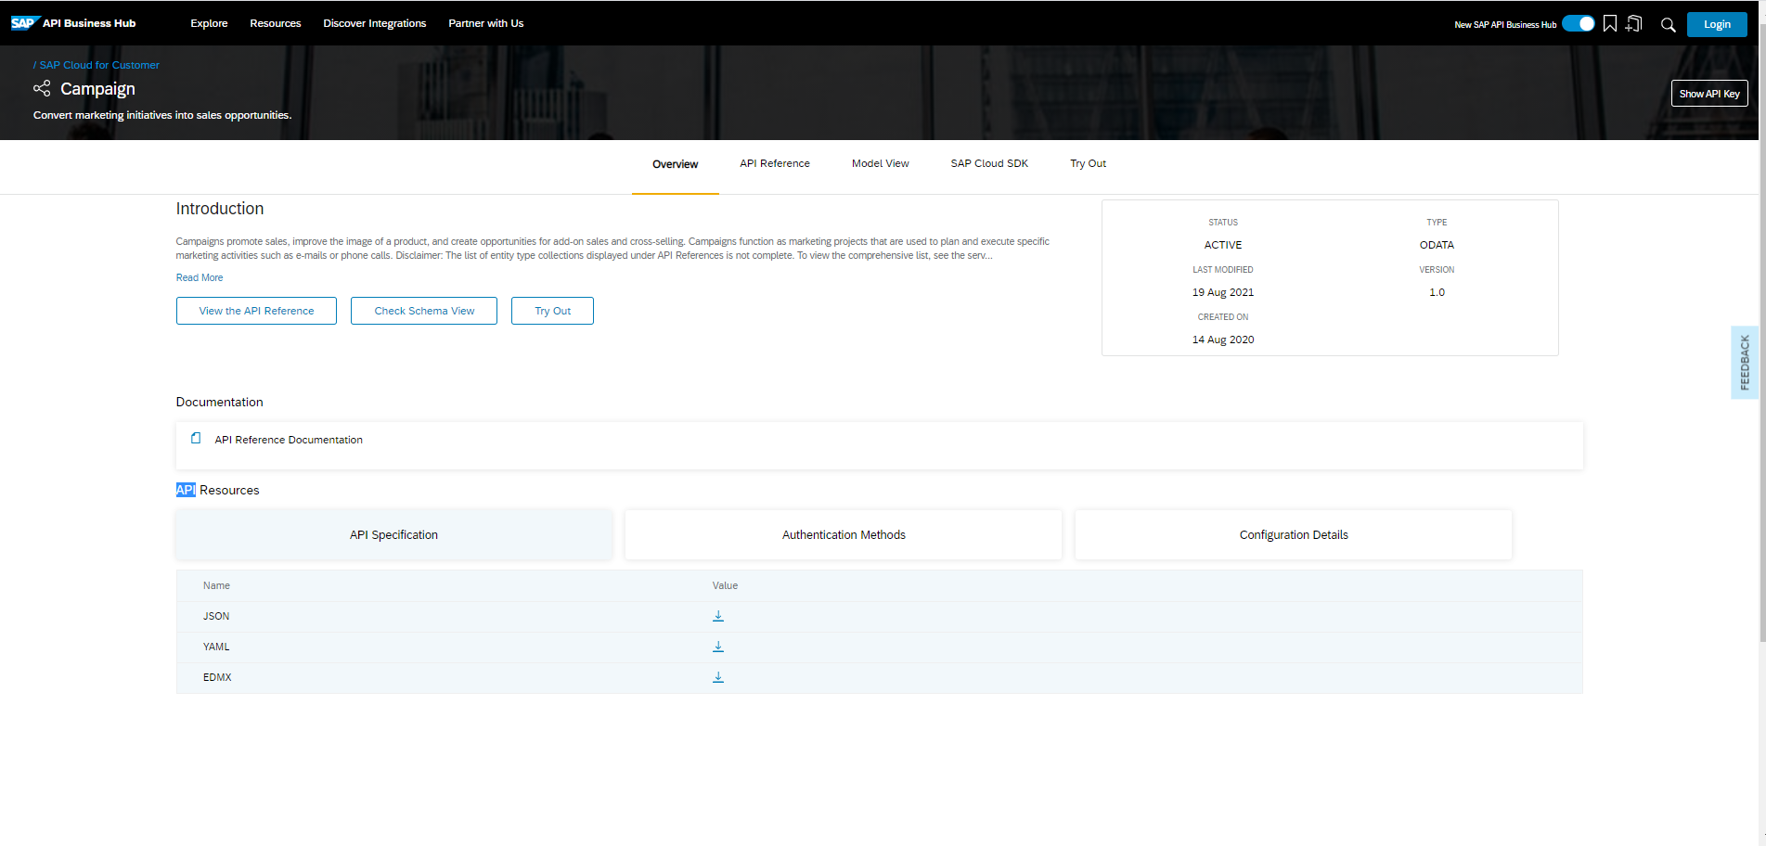
The Overview section briefs you about the API. From here you can download the API reference file, view the documentation available, and check for the API version.
The API Reference section provides information and functions that are offered to consume the API.

Slide 39
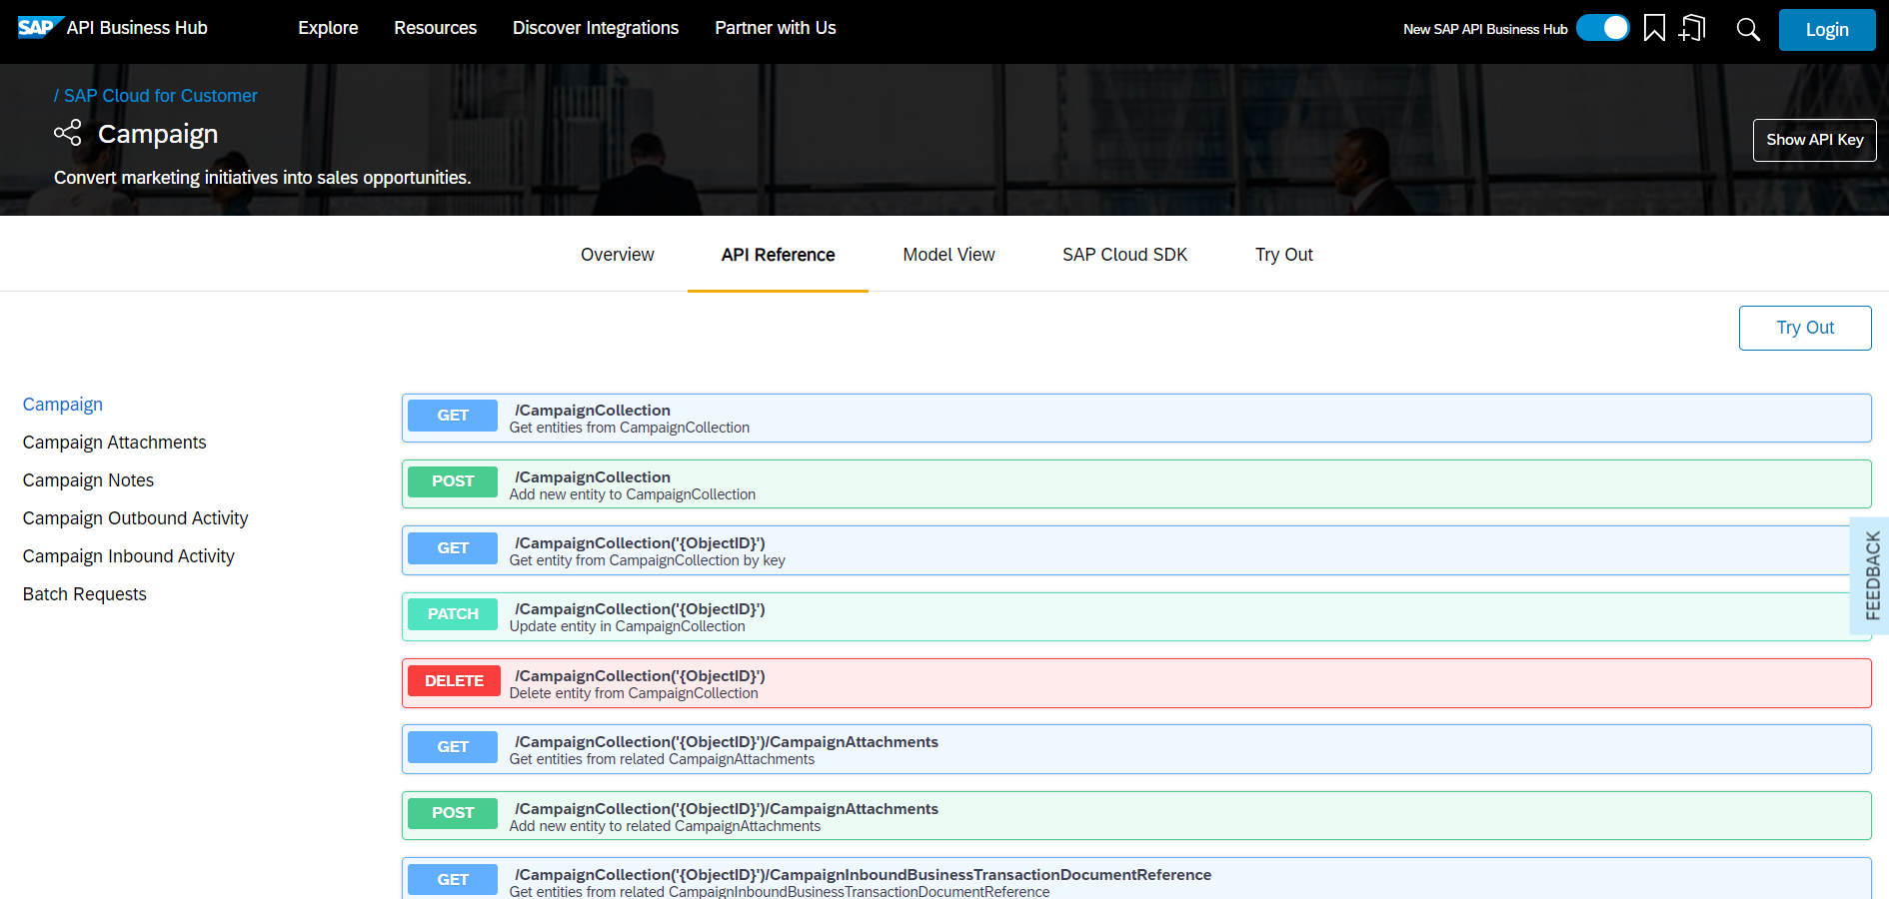
The API can contain one or more endpoints which are organized into groups. On the left-hand side of selected API - Campaign, you can see six groups of endpoints.

Slide 40
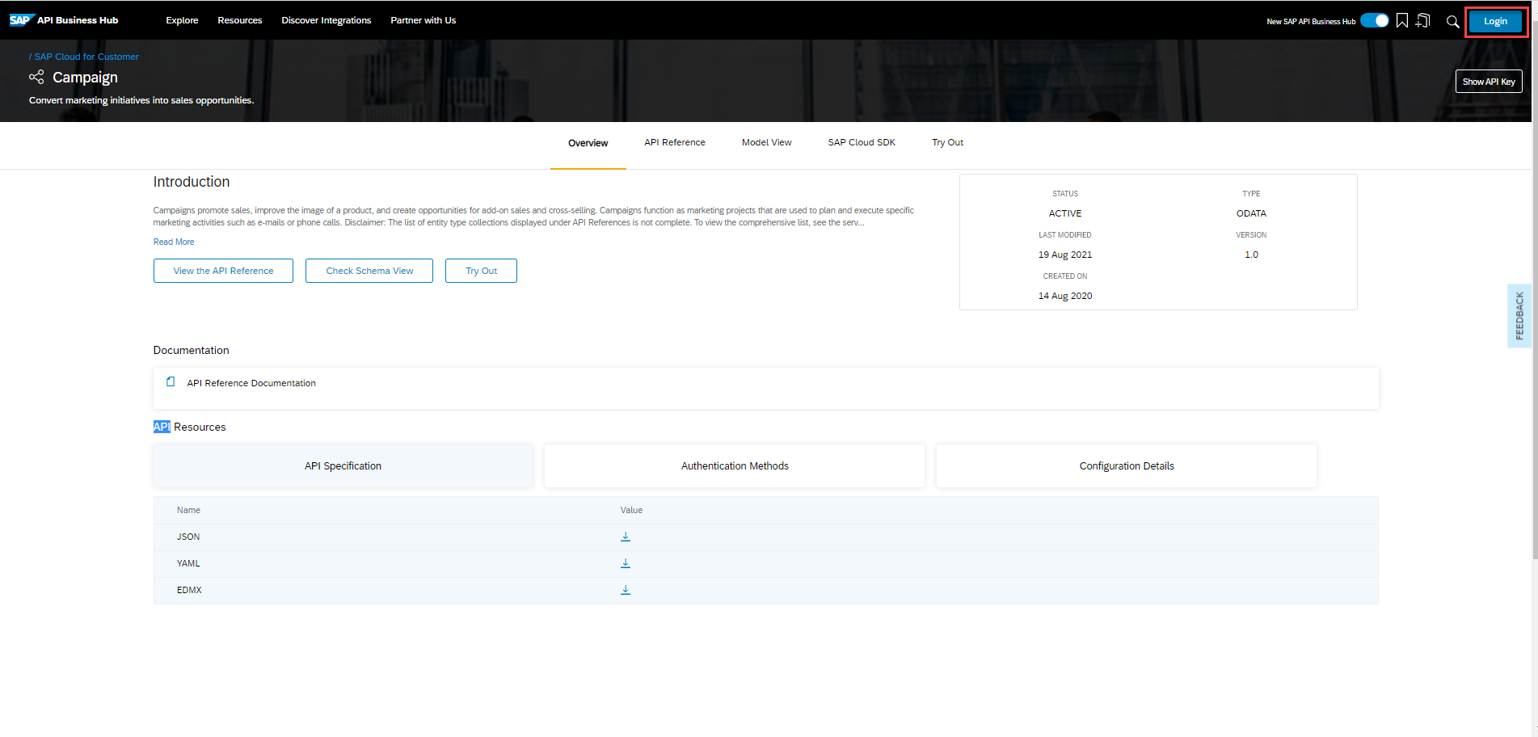
Step 5 Test an API endpoint
The SAP API Business Hub allows you to test APIs. A sandbox environment is provided to test the Campaign API. To take advantage of this, ensure you are logged on. Select Login at the top of the page.

Slide 41
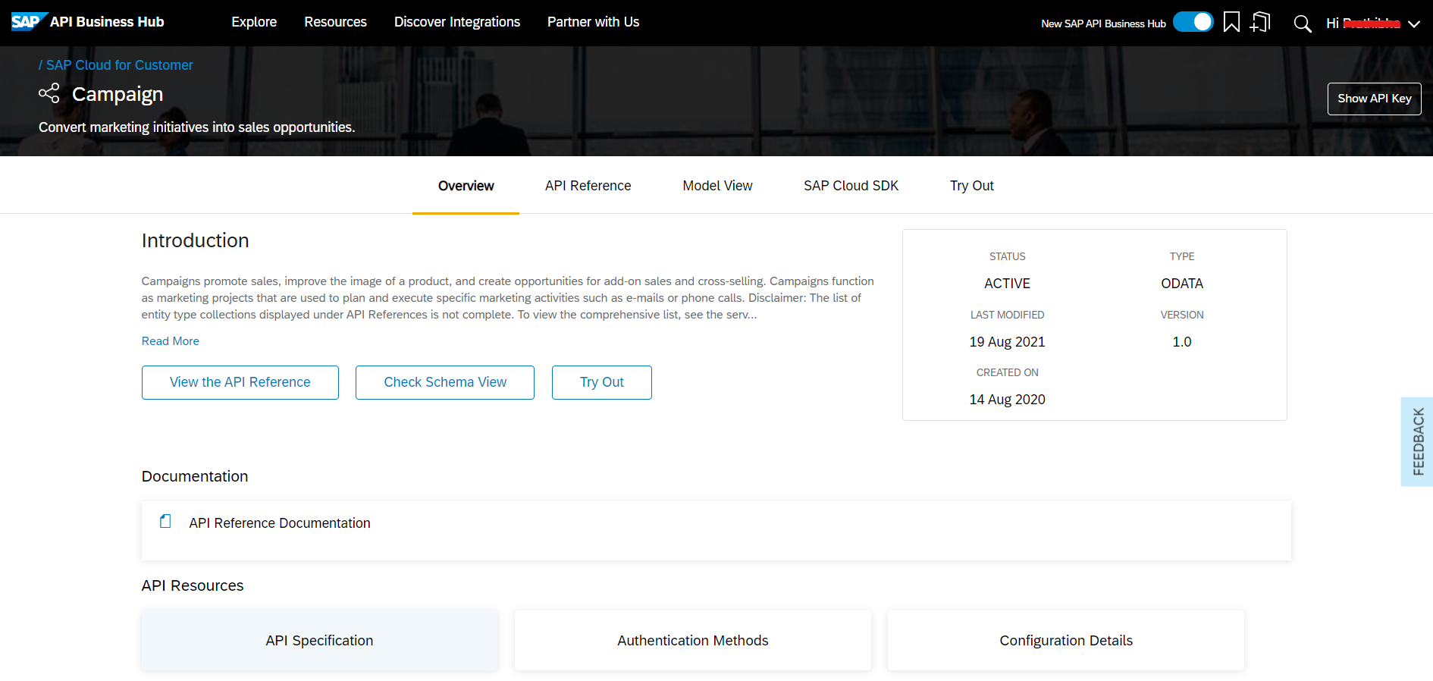
Once logged on, choose the Try Out button in the Overview section.

Slide 42
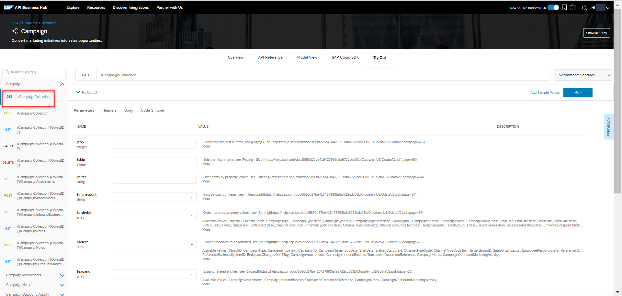
Selecting this will open the Try Out View.
For the purpose of this tutorial the GET /CampaignCollection operation has been selected for testing.

Slide 43
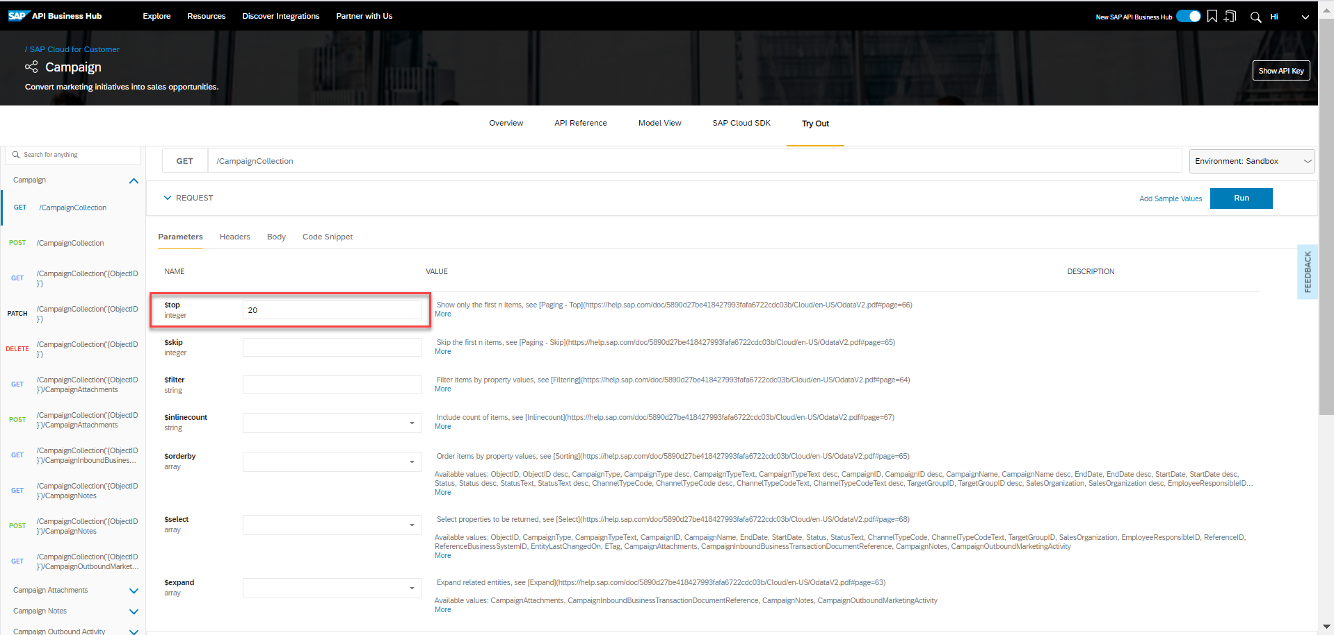
Calling the GET operation on the /CampaignCollection endpoint will return a list of entities from Campaign Collection. The $top parameter can be used to retrieve only the first n results once all the other filtering is done. Specify a value of 20 for this parameter.

Slide 44
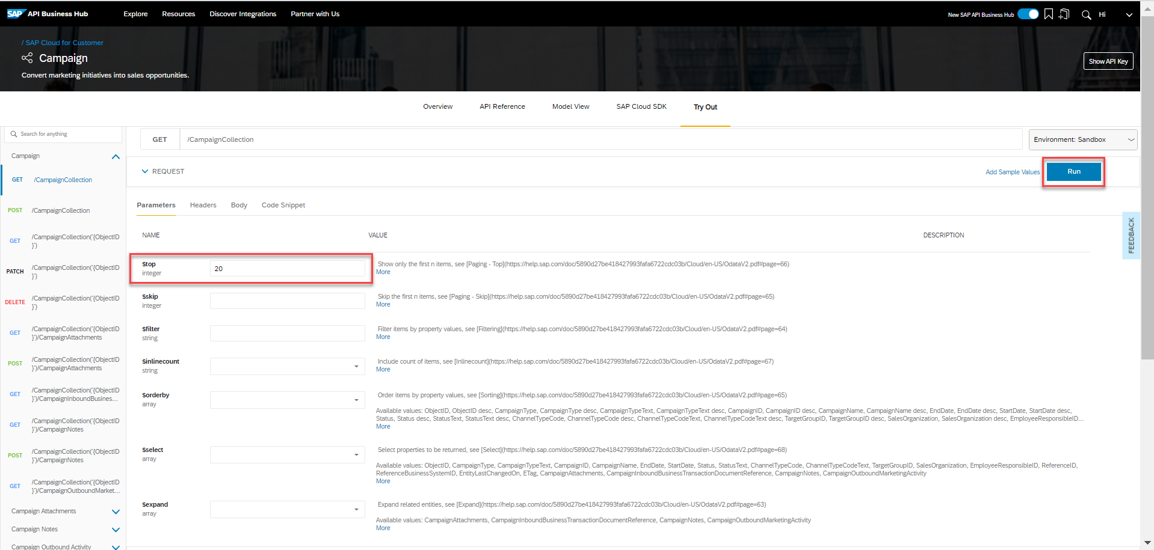
You can also select the $orderby to sort the display order based on Object ID, Object ID description, Campaign Type, and so on.
Once the required inputs are entered, Choose Run at the top right corner to view the response.

Slide 45
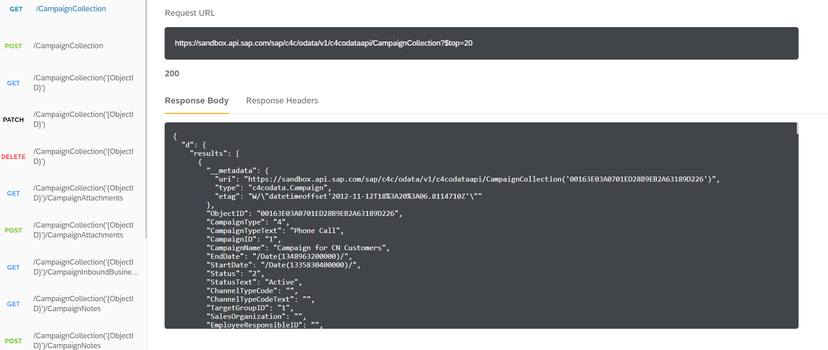
The response section displays various entities fetched calling the GET method.

Slide 46
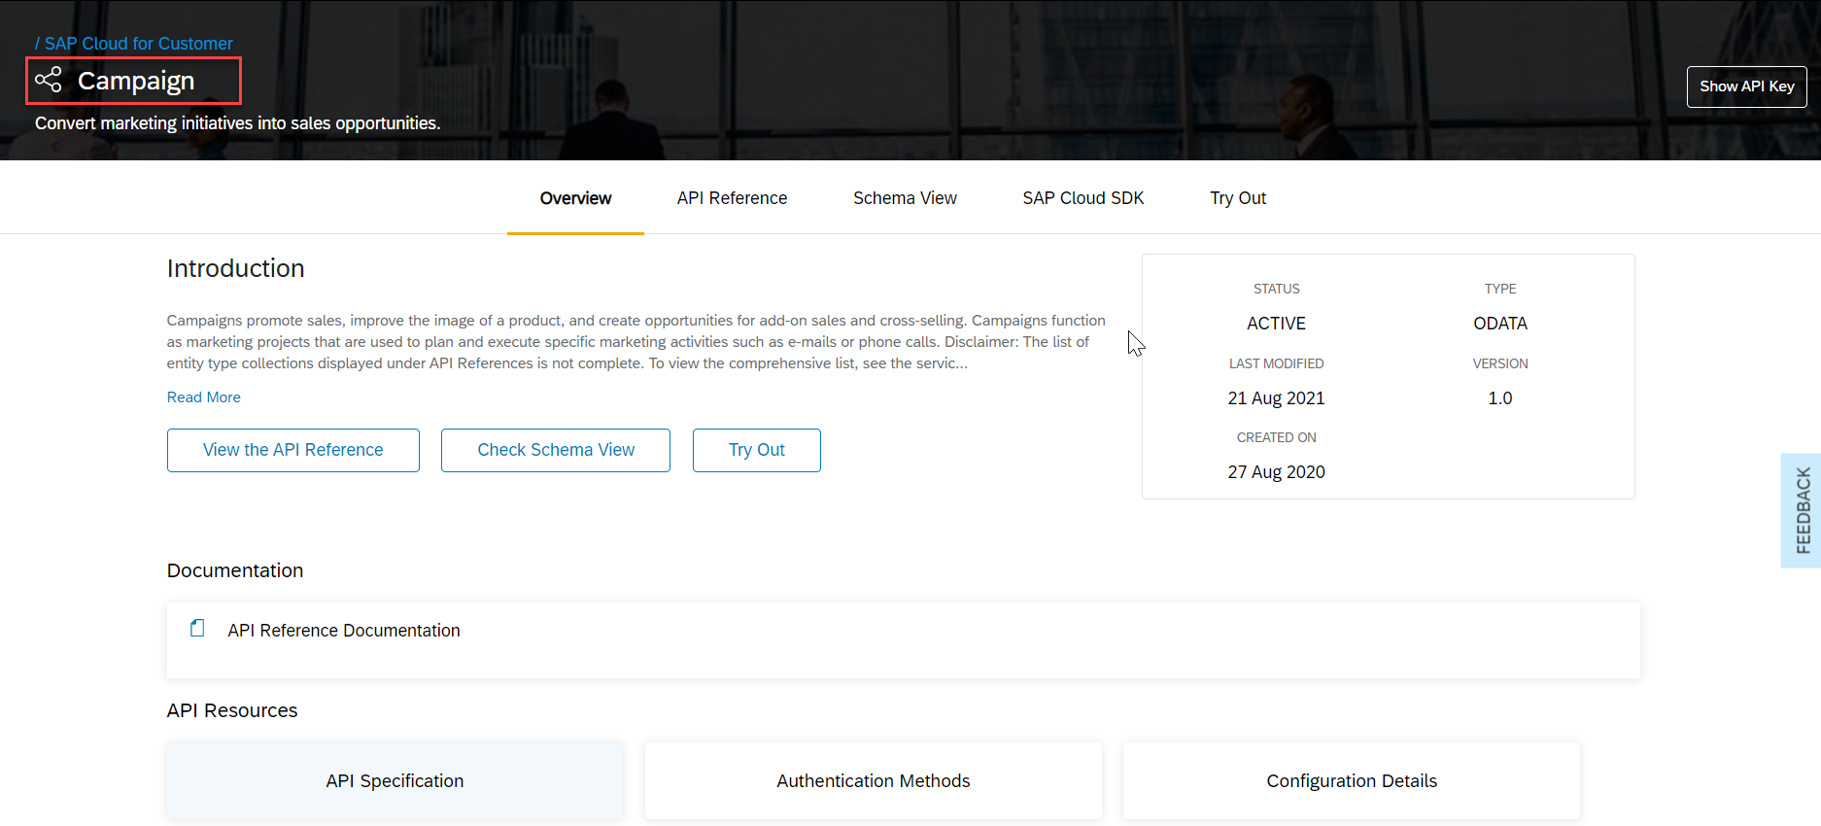
Step 6 Navigate to the User Management API
Go to https://api.sap.com and navigate to the Campaign API.

Slide 47
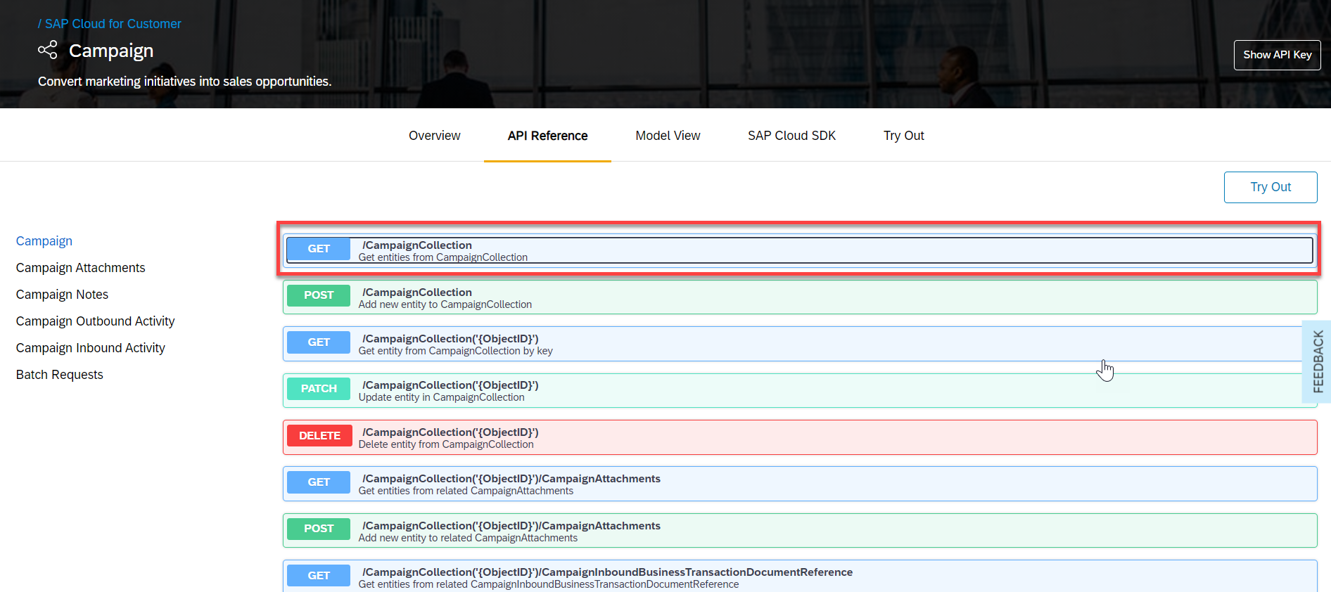
Step 8 Generate sample API call code
Select GET/CampaignCollection method under API Reference. Glance through the GET/CampaignCollection to understand the parameters. The SAP API Business Hub provides you with starter code in a variety of languages and tools for each API.

Slide 48
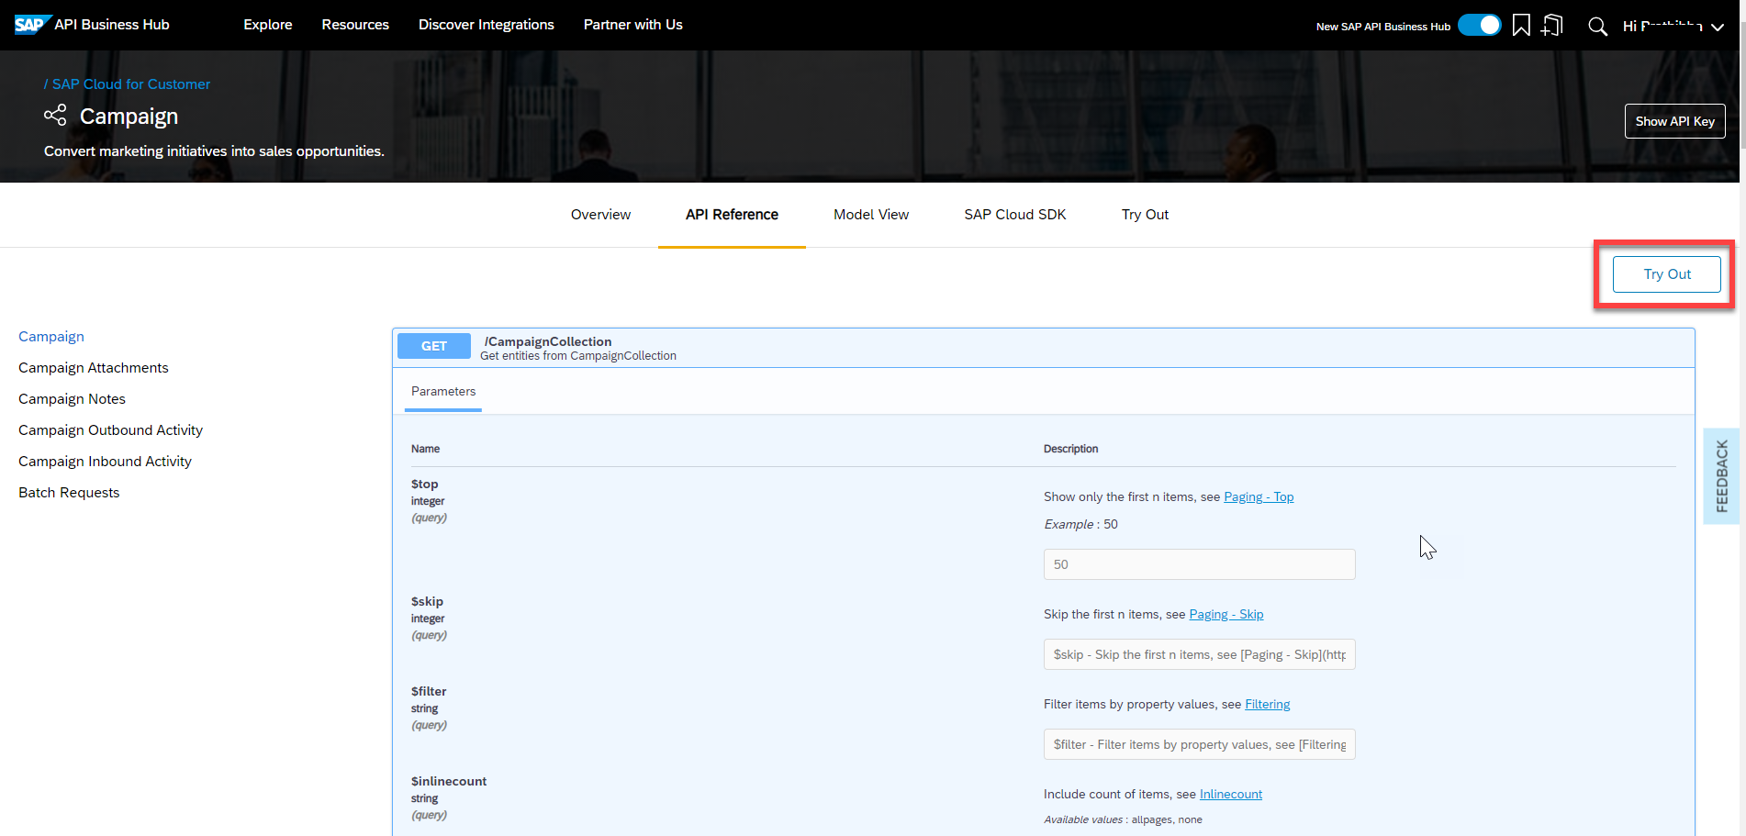
Choose Try Out to proceed further.

Slide 51
SAP API Management
More and more companies are facing the need to open up their data to end customers, business partners and technology partners. This need emanates from business requirements such as apps for employees, apps for customers, simplified integration with SaaS applications or business partners.
Over the last 10 years, REST APIs have emerged as the de facto standard for communication of apps, web applications and integration scenario

Slide 52
Using an API Management layer will allow companies to:
create an Omni-channel experience for customers and employees (mobile, web, devices)
implement simplified Integration with various ecosystems (partners, suppliers, marketplaces etc.)
expose data with external ecosystems to generate new revenue streams (Data-as-a-Service)

Slide 53
SAP API Management allows to efficiently address the requirements of the above mentioned challenges through the following key features:
Configuration instead of coding: managing APIs consists of applying standard features in the areas of security, traffic management and mediation. All these features are pre-defined within SAP API Management, and simply need to be adapted to your needs.
Efficient API Publishing: one of the most important aspects of API Management, is to simplify API consumption for the Application Developer. Hence API Management provides a self-service and integrated Developer Portal, featuring self-service capabilities, searching, documentation, testing and subscription capabilities.
This allows to reduce the time and effort of onboarding Developers, allowing for better time-to-market and reduced costs.

Slide 54
Broad analytics: API usage is not limited to internal consumption, hence monitoring and analytics are even more relevant than before. API Management provides central, technical and business-driven analytic capabilities.
This allows to quickly solve issues for increased user satisfaction and to steer your API program for an optimal return on investment of your digitalization projects.

Slide 55
High-level architecture
From a high-level perspective, SAP API Management is divided in 2 main areas: designing APIs through the API Portal, and providing APIs through the Developer Portal.

Slide 56
https://blogs.sap.com/2019/03/13/cloud-integration-how-to-create-a-sample-integration-scenario-using-open-connectors-adapter/

Slide 57

Summarize
LET’S SUMMARISE!

Slide 58

Summarize
End of Day 1

Slide 60


We’re committed to empower you to be
#FutureReady
through powerful training solutions.
We build the workforce of the future.
250+
Corporate Clients
30,000+
Learners Trained
25000+
Learners Placed
FREE WEBINARS
Sign up for free webinars with industry experts every fortnight!
Enroll Now!
Contact us today!
https://anubhavtrainings.com

